Slide 1


Data Collection
Data Exploration
THE DATA'S
JOURNEY
Cleaning &
Normalization
Analysis
Hypothesis
Validation
Notes:
b

Slide 2


CONTINUING OUR JOURNEY
EXPLORATORY DATA ANALYSIS
DATA COLLECTION
DATA ANALYSIS
MODEL EVALUATION
CLEANING, SET-UP & NORMALIZATION
PREPROCESSING

Slide 3
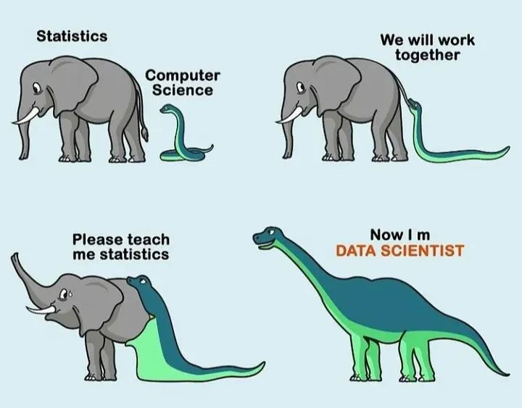

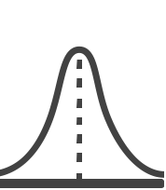
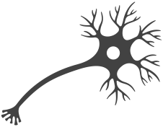
WHAT IS DATA SCIENCE?
PROGRAMMING
ML/AI
DATA
SCIENCE
MATH & STATISTICS
DOMAIN KNOWLEDGE

Slide 4
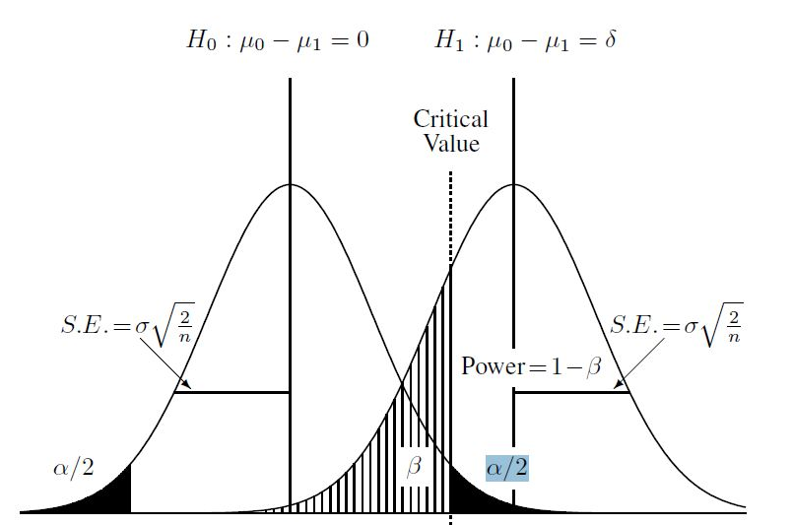
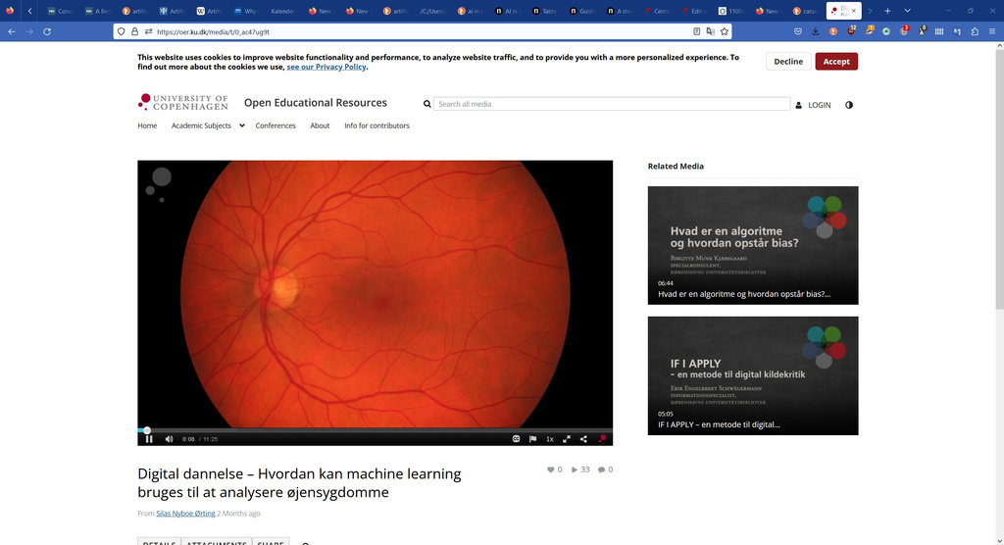
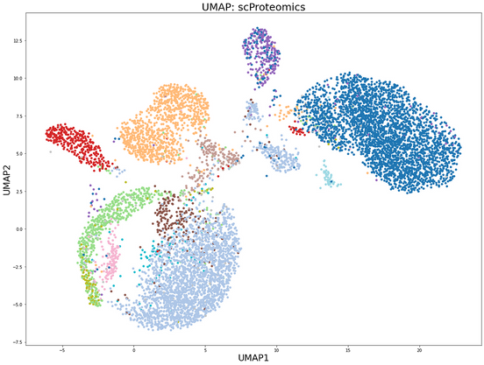
DATA SCIENCE ANALYSIS
HYPOTHESIS TESTING
PREDICTION/ CLASSIFICATION
UNSUPERVISED LEARNING
RQ: Does this patient have a cataract?
RQ: What sets the cancer cells apart from the healthy cells?
Are there subtypes within one cell type?
RQ: Is there a significant difference in the variable of interest between two or more groups?
RQ: Can we estimate cancer risk based on genetic risk, smoking and age?
Notes:
Many research questions fit roughly into one of these boxes
Research questions can also combine these areas.

Slide 5
DATA SCIENCE ANALYSIS
STATISTICS:
Focus is on inference*, achieved through fitting of a probability model
Quantitative measure of confidence of a 'true' effect (confidence interval)
We have data/model assumptions which we must verify
Statistical models can do predictions, but predictive accuracy is not their strength[1]. BUT interpretable.
MACHINE LEARNING
DATA SCIENCE
3. UNSUPERVISED LEARNING
2. PREDICTION/ CLASSIFICATION
1. HYPOTHESIS TESTING
STATISTICS
[1] Bzdok, D., Altman, N. & Krzywinski, M. Statistics versus machine learning. Nat Methods 15, 233–234 (2018).
Notes:
Inference = process of using a sample to infer the properties of a population

Slide 6
DATA SCIENCE ANALYSIS
MACHINE LEARNING:
Purpose is prediction/classification, finding patterns in large data
Makes minimal assumptions about the data
When the number of input variables exceed observation
Appropriate for complicated nonlinear interactions
Provide a degree of interpretability, but tends to sacrifice interpretability for predictive power[1].
MACHINE LEARNING
DATA SCIENCE
3. UNSUPERVISED LEARNING
2. PREDICTION/ CLASSIFICATION
1. HYPOTHESIS TESTING
STATISTICS
[1] Bzdok, D., Altman, N. & Krzywinski, M. Statistics versus machine learning. Nat Methods 15, 233–234 (2018).

Slide 7
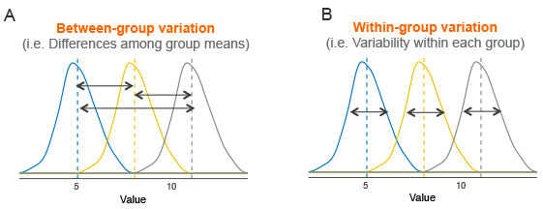
HYPOTHESIS TESTING
Questions that boil down to:
Is there a difference in feature A between these two or more groups?
Is the bacterial load higher in colon swaps of cancer patients?
Is the expression of gene A higher in tumor samples?
Is there a difference in median height between men and women?
A difference test:
t-test
ANOVA
Fisher’s exact test
Notes:
t-test (difference between two means)
ANOVA (difference between two or more means)
Fisher’s exact test (association between categorical variables)*

Slide 8
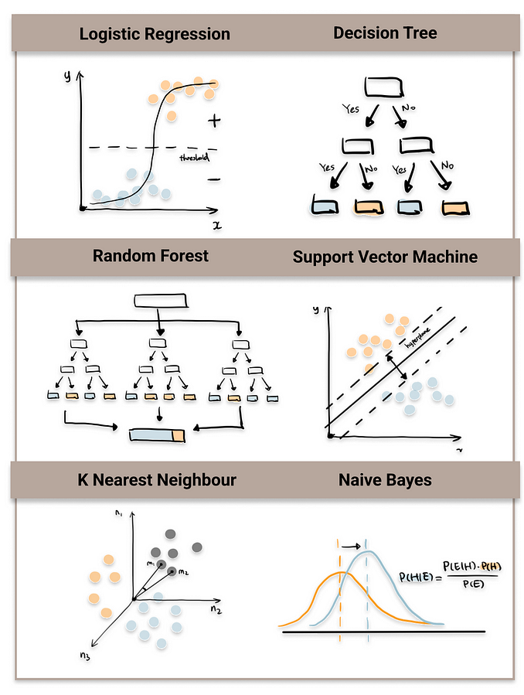
PREDICTIVE MODEL / CLASSIFICATION
Using statistical/ML models to predict outcomes / classify new data.
Discovering and quantifying the relationships between predictor variables and outcome.
Prediction (Regression) == outcome is continuous (weight of newborn)
Classification == outcome is a class/group (cystic fibrosis or healthy)
Logistic Regression
Naïve Bayes
Support Vector Machine
Random Forest
K-Nearest Neightbors
https://towardsdatascience.com/top-machine-learning-algorithms-for-classification-2197870ff501

Slide 9
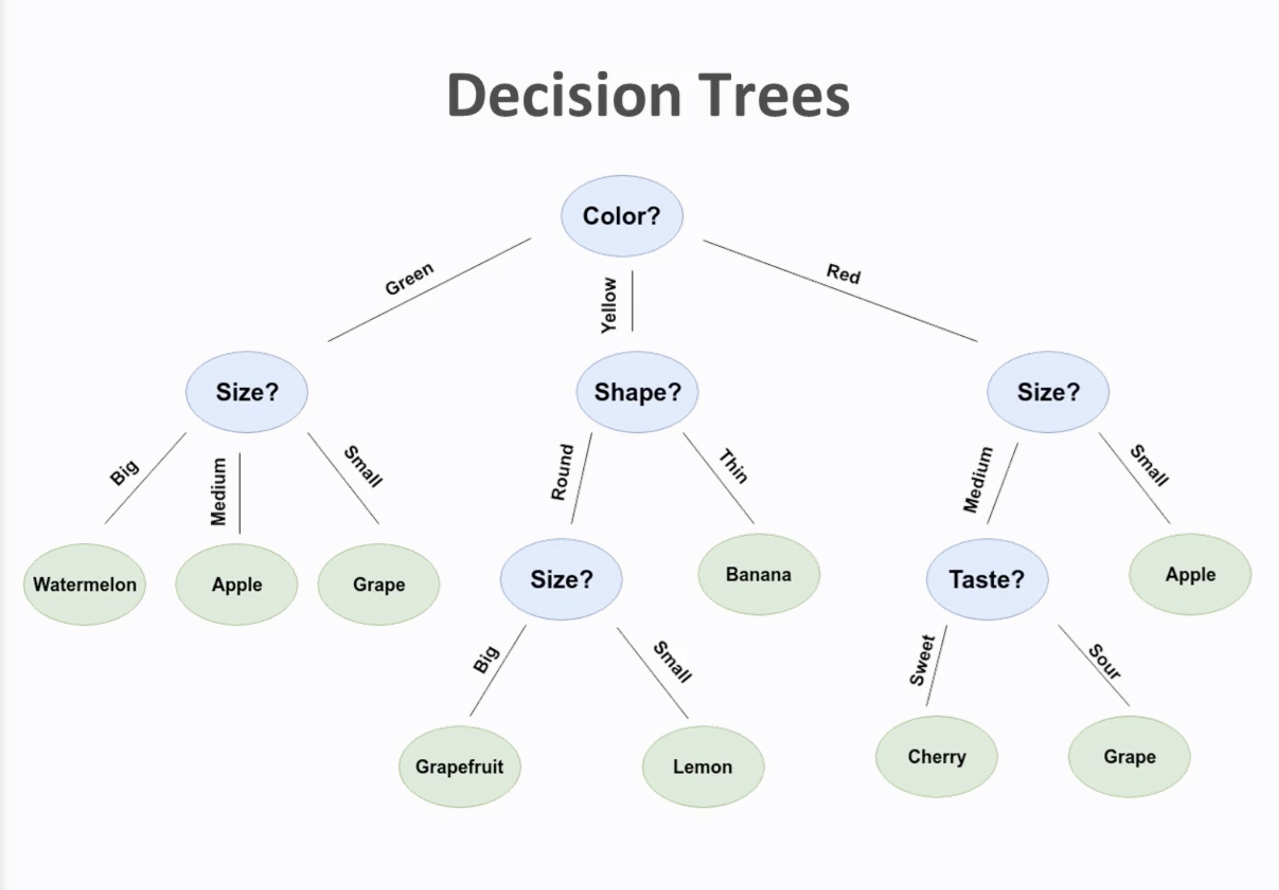
CLASSIFICATION OF FRUIT - EXAMPLE
A model trained and evaluated using class labels is used to classify a new data point (label unknown).
Probability (0.68 Grapefruit & 0.32 Lemon)
Response (Grapefruit)
Some models have feature importance ranking.
What feature/variable is most important for classification, i.e. size, shape or color?
Decision Tree – Fruit Classification

Slide 10
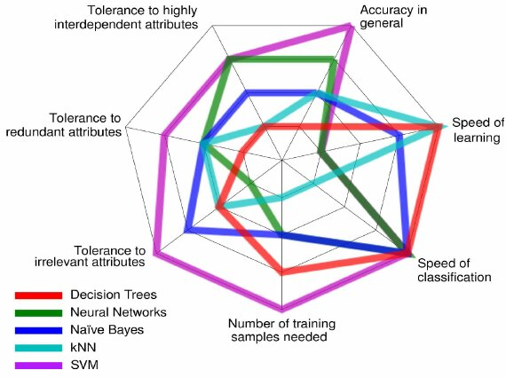
CLASSIFICATION ALGORITHMS – PROS & CONS
Pros and cons of different classification methods
Depending on the scientific question and the data type/size a specific method may be favorable
Here is a plot comparing algorithms, it is called a spider / radar plot

Slide 11
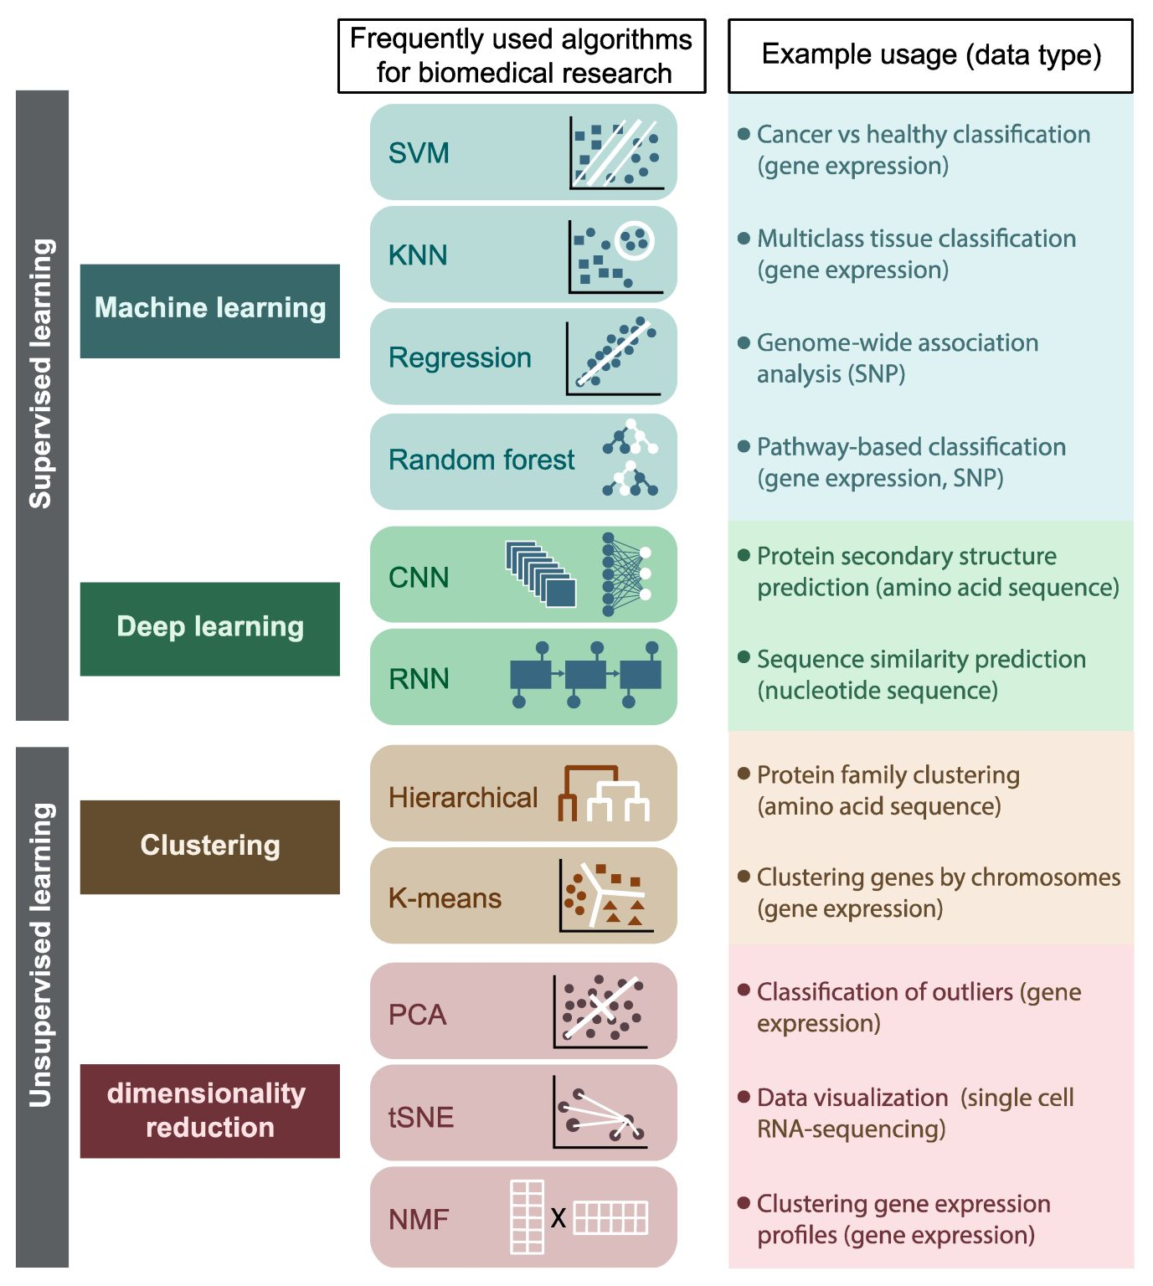
SUPERVISED LEARNING
Classification: Fit/train a model which can assign a new observation to a given class (i.e. cancer vs healthy).
Classification problems are solved using supervised or unsupervised learning
Supervised Classification: Our model is trained using labeled observations - we know the ‘ground truth’ .
Notes:
Technical variation that affect different samples differently
This can obscure difference or create differences that are not real
We want to remove this variation as much as possible since we are interested in biological variation
Critically important for omics data analysis

Slide 12


GROUP DISCUSSION
In your groups discuss:
What is a research question within your field(s) where you would use predictive modelling for classification?
What model do/could you use? (see previous slides)
If you had no ‘ground truth’ (no labels) to use for model training, do you think you could solve a classification problem regardless? If so, what would the scientific question be?

Slide 13
UNSUPERVISED LEARNING
What if we do not know the groups our data partition into, no labels…
A scientific question could be:
Do our observations stratify into groups and what data characteristics drive this partitioning?
For this we use unsupervised learning methods (PCA is one example).
Notes:
Technical variation that affect different samples differently
This can obscure difference or create differences that are not real
We want to remove this variation as much as possible since we are interested in biological variation
Critically important for omics data analysis

Slide 14
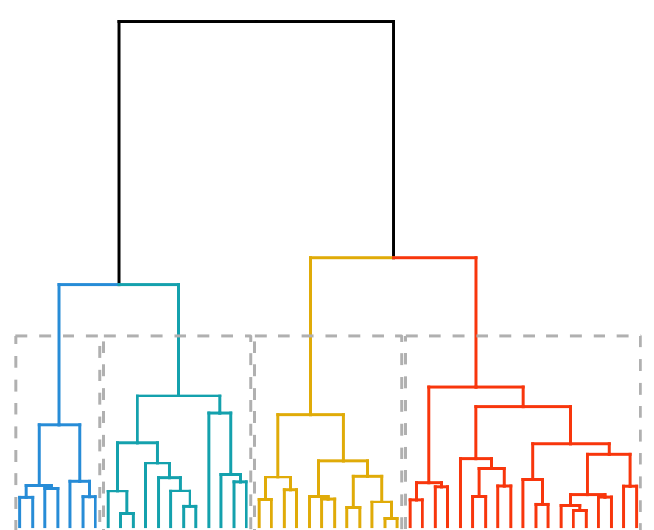
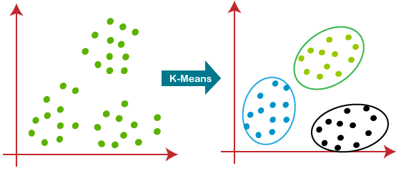
CLUSTERING
Hierarchical Clustering:
Complete linkage
Ward’s method
Clustering == type of unsupervised learning.
Metric to define similarity of observations.
Items of a group share features that we care about.
RQ:
Optimal number of clusters for this dataset? What characterizes a certain cluster?
Which cluster does a new data point belong to?
K-Means Clustering:
Euclidean distance
Manhatten distance

Slide 15
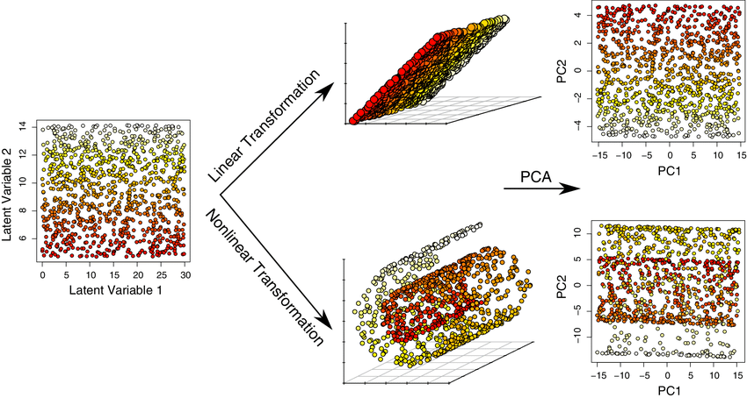
DIMENSIONALITY REDUCTION
Dimensionality reduction (DR) methods project data from a high dimensional space into a low dimensional space.
DR methods are unsupervised.
Linear projection:
PCA = principal component analysis
Non-linear projection:
t-sne = t-distributed stochastic neighbor embedding
UMAP = Uniform Manifold Approximation and Projection

Slide 16
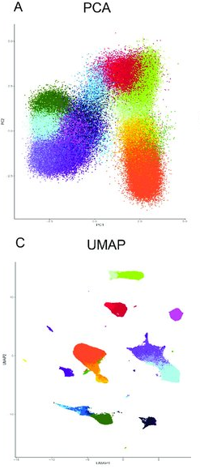
VISUAL CLUSTERING BASED ON DR
DR is not a method for clustering, BUT it is used in this way.
Clustering based on DR == visual inspection of plot to identify clusters.
Coloring observations by meta-information (i.e. cancer grade, drug treatment or cell type,…) may support ground truth.
DR methods can have parameters which should be specified correctly as they will affect results.
Liu, Peng, et al. Frontiers in cell and developmental biology 8 (2020): 234.

Slide 17
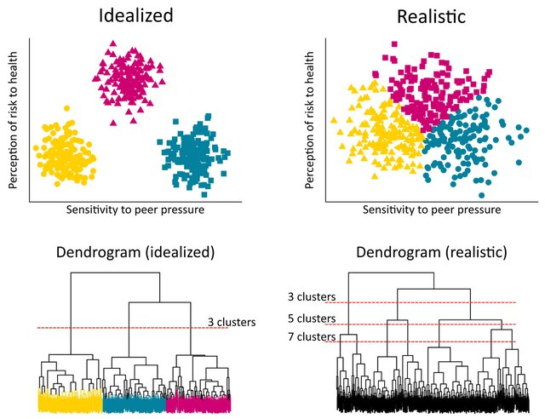
CHALLENGES
How to define similarity?
Human tendency to see clusters in randomness (clustering illusion)
Algorithm may require the user to specify the number of clusters (chicken-and-egg problem)
Non-linear clustering algorithms are powerful but can have unexpected behaviors (parameters)
Engl, Elisabeth, Peter Smittenaar, and Sema K. Sgaier. Gates Open Research 3 (2019).

Slide 18
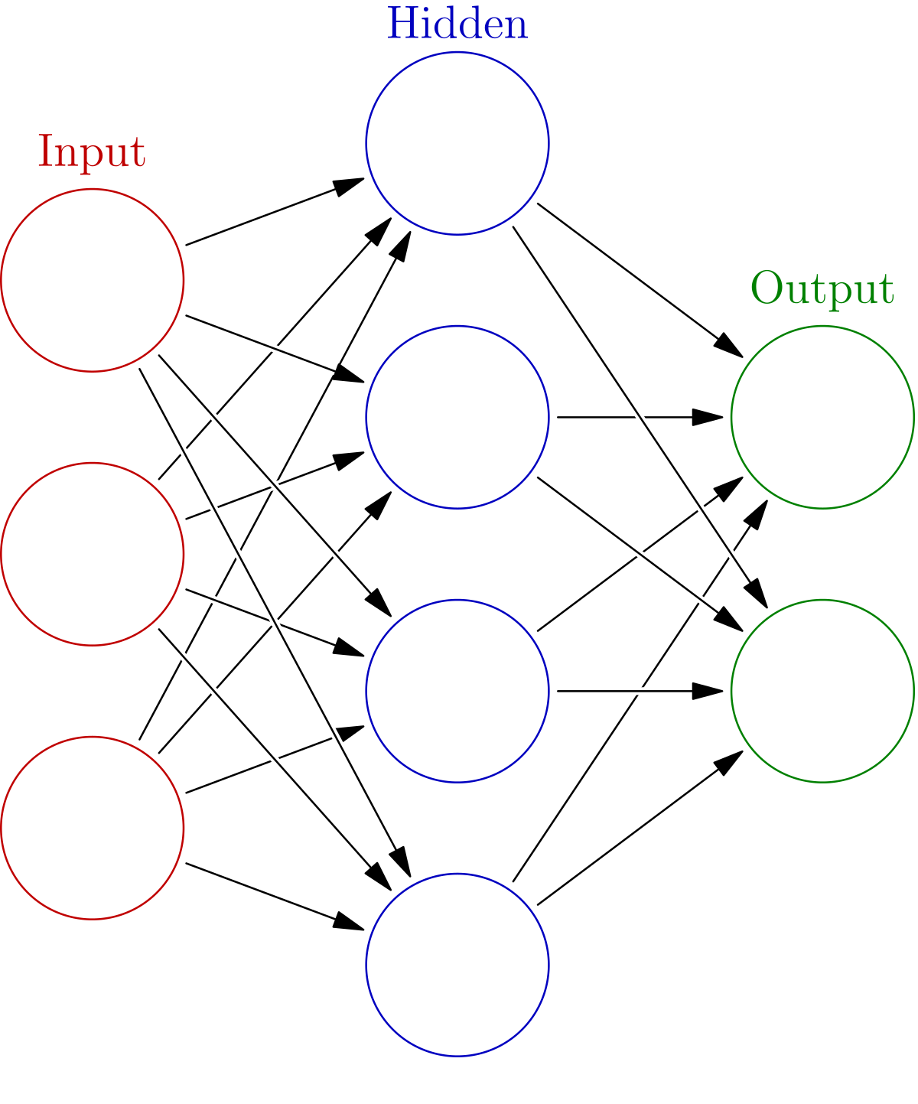
NEURAL NETWORKS
Neural Networks (NN) mimic the function and structure of the human brain
NN can be either supervised or unsupervised
We use NN for medical image analysis, genomics analysis, protein structure prediction, etc.
NN can be difficult to understand in detail but not in broad strokes, let's try…

Slide 19
NEURAL NETWORK FOR CLASSIFICATION
Input layer: Data goes in (i.e. patient biometrics, expression data, medical images)
Hidden layer: The model learns data patterns.
This is where the computation is performed.
Many hidden layers == deep neural network
Output layer: Samples are classified as either cancer or healthy.
Forward Propagation == network predicts
Gly. Level
Age
Healthy
BMI
Diabetes
Back Propagation == Networks learns using errors

Slide 20

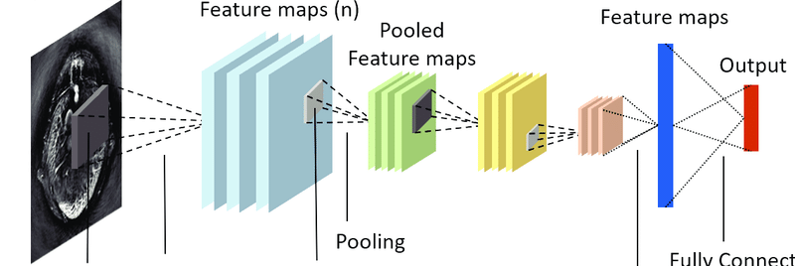
MEDICAL IMAGE ANALYSIS
The many Data Scientists do NOT make their own NNs, but they use them…
Many implementations of NNs in different programming languages.
There are different types of neural networks (NNs)
Different neural networks are good for different data and tasks
NNs for medical image analysis are often convolutional neural networks (CNNs).
CONVOLUTIONAL NEURAL NETWORK
Yang, Changchun, et al. "Review of deep learning for photoacoustic imaging." Photoacoustics 21 (2021): 100215.

Slide 21


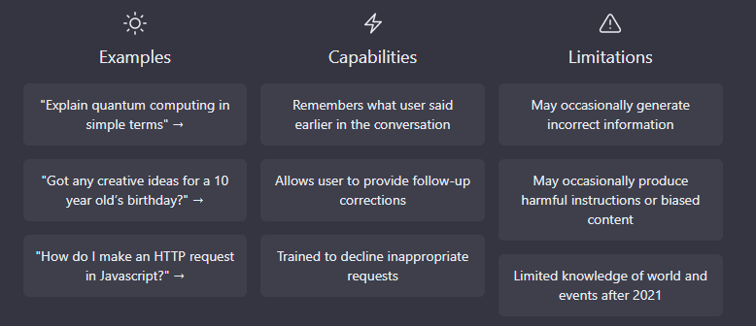
ChatGPT
You may already have used or heard about ChatGPT
The algorithm behind is a Transformer Neural Network
This AI bot can do many things, also programming!

Slide 22
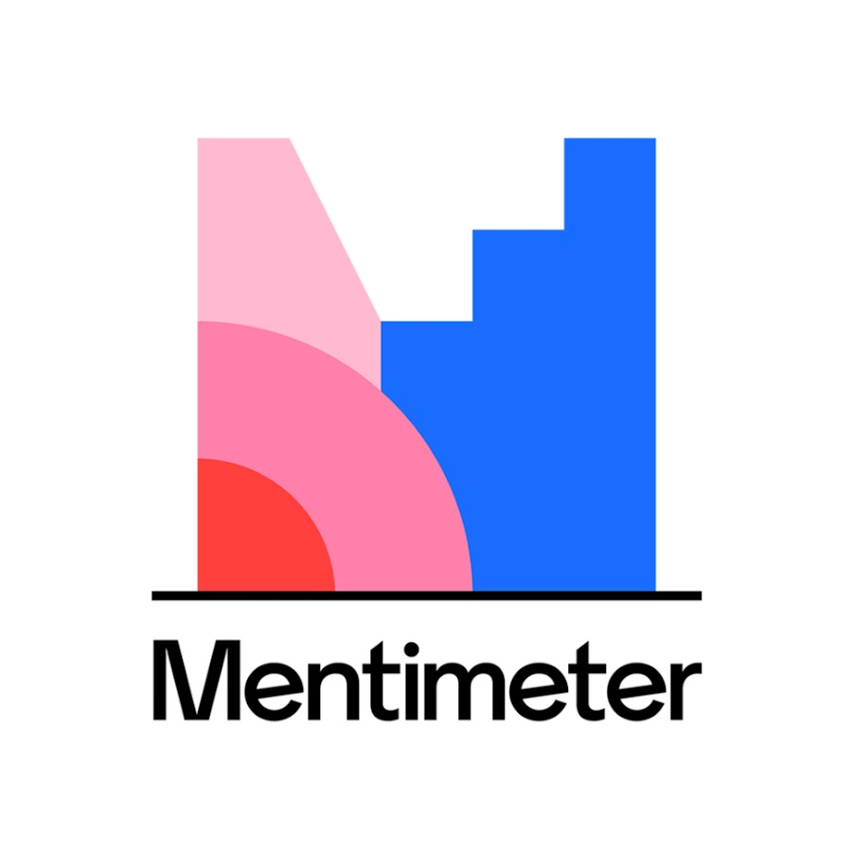

Have you used any of the models we’ve talked about in this section?

Slide 23
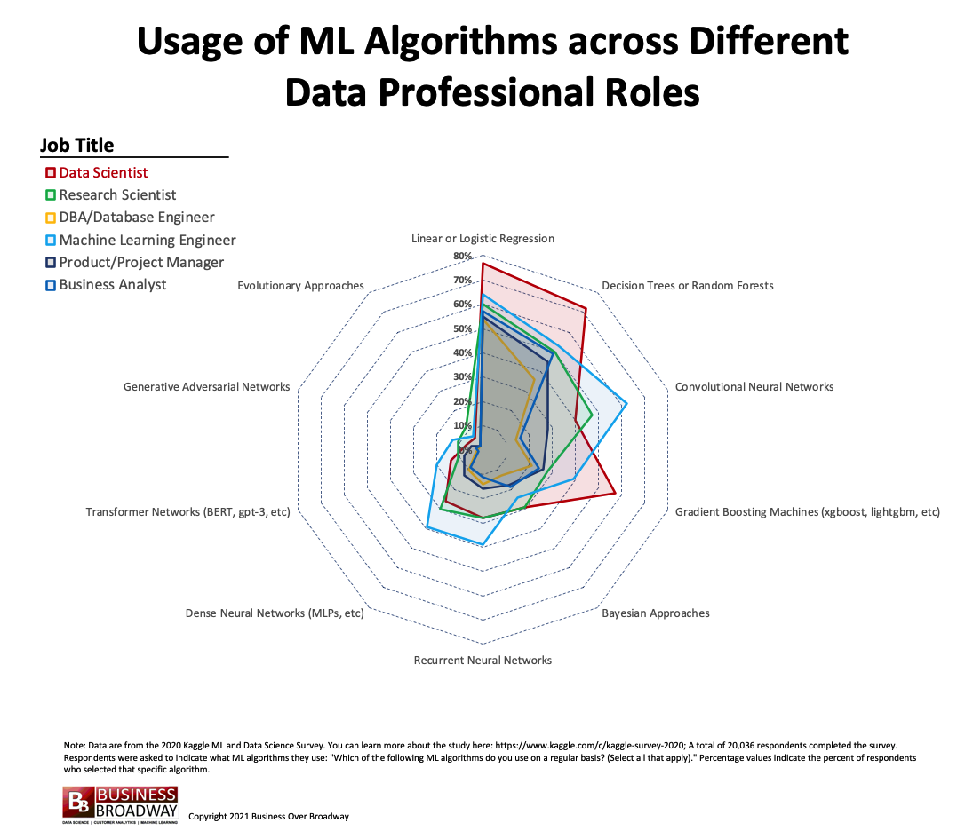

Slide 24
WHICH APROACH SHOULD WE USE?
STATISTICAL ANALYSIS
MACHINE LEARNING
’Simple’ question
Linear relationships
Small dataset (few obs.)
High dimensional data
Non-linear relationships
SUPERVISED
UNSUPERVISED
The scientific questions asked are central to the methods chosen.
The dataset size guides choice of algorithm.
Outcome is known
Outcome is unknown
Fully data driven
Notes:
Technical variation that affect different samples differently
This can obscure difference or create differences that are not real
We want to remove this variation as much as possible since we are interested in biological variation
There is of course background noise in our data, this can sometimes modelled and sometimes it is so little and random we do not expect it to affect our analysis, in that case we simply ignore it.

Slide 25
GROUP DISCUSSION
In your groups discuss which of the three areas of DS analysis we talked about best applies to this question.
Is there a difference in weight between mice of strain A and strain B?
Further discuss:
What types of variables (data types) do we have? Do you know of any test you could use to answer this question?

Slide 26
GROUP DISCUSSION
In your groups discuss which of the three areas of DS analysis we talked about best applies to this question.
You have protein abundance data from skin samples (~ 10.000 different protein species). These samples were collected from patients with psoriasis (normal adjacent -and affected skin) and from healthy controls.
Is protein abundance predictive of the skin phenotype? And if so, are the levels of all proteins equally predictive/informative?

Slide 27
GROUP DISCUSSION
In your groups discuss which of the three areas of DS analysis we talked about best applies to this question.
Is the amount of bacterial load in a swap of the oral epithelium (gums) based on skin type, diet and whether the person recently had antibiotic treatment?
Further discuss:
What are the outcome variable(s) and the explanatory variable(s) in this scenario?

Slide 28
GROUP DISCUSSION
In your groups discuss which of the three areas of DS analysis we talked about best applies to this question.
Gene expression data and biometrics (height, weight, age, etc.) from patients with colorectal cancer. You are interested in exploring if there are any potential subgroups of cancer patients within your dataset, in order to pair each subgroup with the appropriate healthy controls.
What type of analysis could you use for this? N.B while avoiding a fishing-expedition

Slide 29


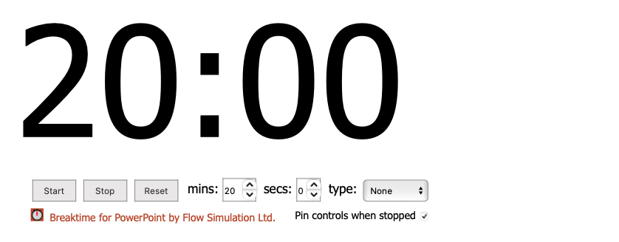
A BREAK IN OUR JOURNEY

